Slide 1
Project: E-retail Customer retention/activation data analysis
Presentation prepared by: Shashanka S

Slide 2
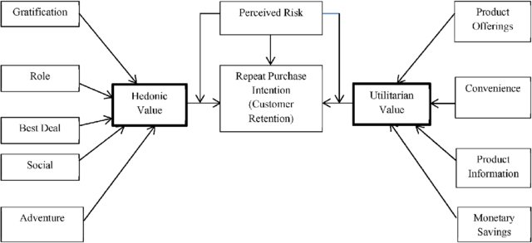
Problem statement
Customer satisfaction has emerged as one of the most important factors that guarantee the success of online store; it has been posited as a key stimulant of purchase, repurchase intentions and customer loyalty.
Five major factors that contributed to the success of an e-commerce store have been identified as: service quality, system quality, information quality, trust and net benefit. The research furthermore investigated the factors that influence the online customers repeat purchase intention.
The combination of both utilitarian value and hedonistic values are needed to affect the repeat purchase intention (loyalty) positively. The data is collected from the Indian online shoppers. Results indicate the e-retail success factors, which are very much critical for customer satisfaction.

Slide 3
Solution along with steps and methodologies used
Importing required libraries
Importing raw data and encoded data from the excel file given
Saving it in Dataframe format
Checking out dimensions of data
Checking out the null or missing values & handling
Checking out types of data present in different columns
Encoding the data
Exploring the data, visualization of data

Slide 4
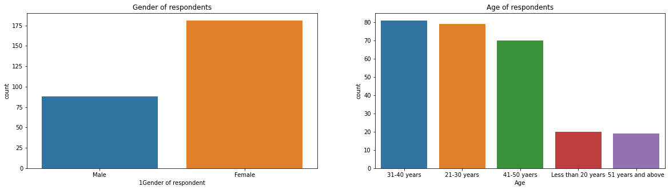
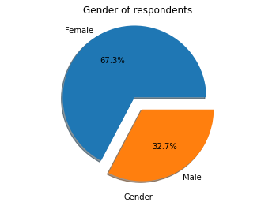
Exploring the data, visualization of data regarding gender and age of respondents
We can infer that most of the respondents are female from the above plots

Slide 5
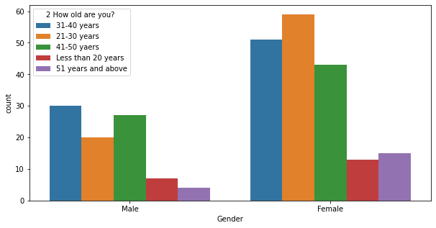
Exploring the data, visualization of data regarding gender and age of respondents
We can infer that most of the respondents are female with the age group of 21-30 years

Slide 6
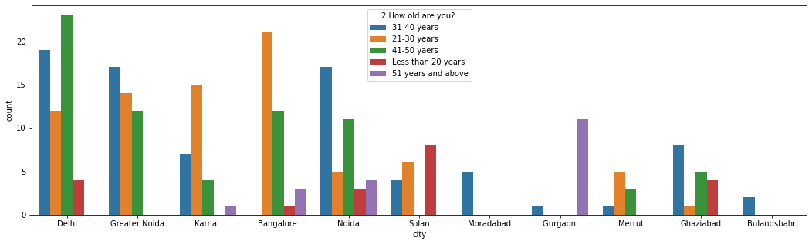
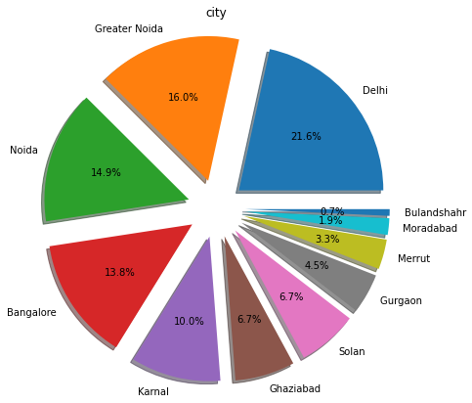
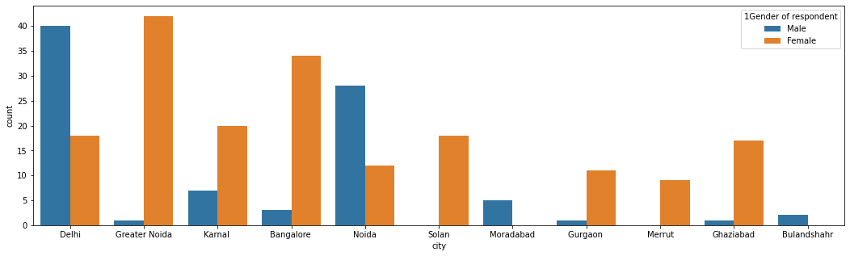
Exploring the data, visualization of data regarding city of the customers
We can infer that in
1) 21.6% of the respondents are from Delhi
2) Most of the respondents from Delhi belongs to 41-50 years age group
3) Majority of the respondents from Delhi are male
Inference varies from city to city

Slide 7
Exploring the data, visualization of data regarding gender and age of respondents
We can infer that most of the respondents are female with the age group of 21-30 years

Slide 8
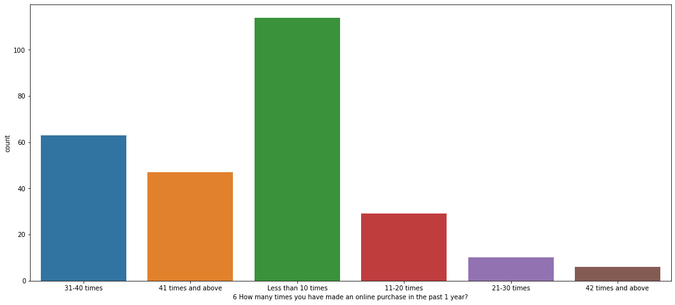
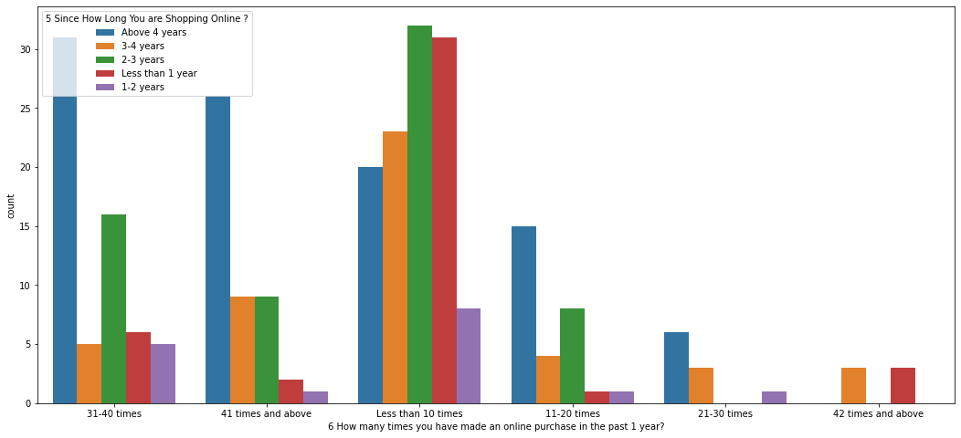
Visualization of data regarding experience and frequency of online shopping
We can infer that:
1) Frequency: Most of the online shopping customers have shopped less than 10 times online in past 1 year
2) Experience: Most of the online shopping customers have shopped has more than 4 years of online shopping experience
3) But for customers who have shopped less than 10 times online in past 1 year, most of them have 2-3 years of online shopping experience

Slide 9
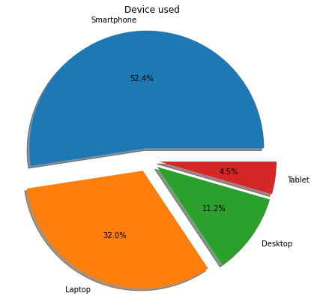
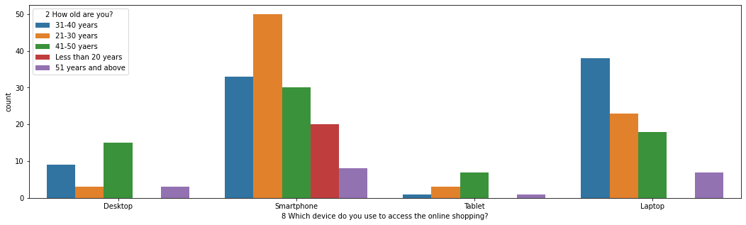
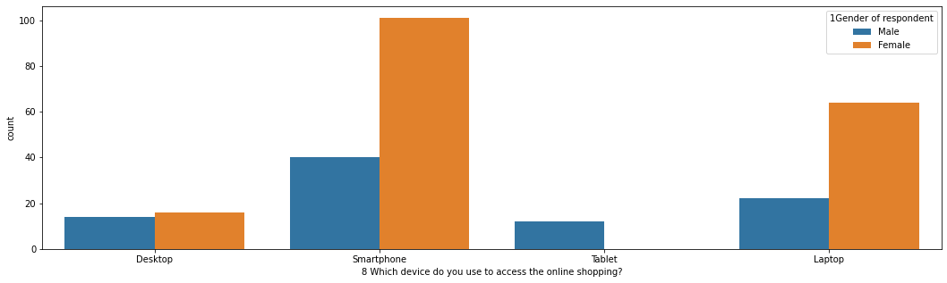
Visualization of data regarding device used for online shopping
We can infer that
1) Most of the customers using smartphone for online shopping belong to age group of 21-30 years
2) Most of the customers using smartphone for online shopping are female

Slide 10
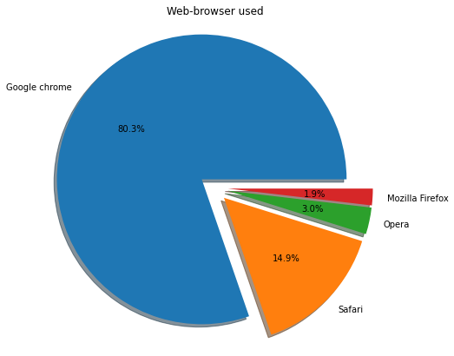
Visualization of data regarding browser used for online shopping
We can infer that most of the online shopping customers prefer google chrome as web-browser while shopping online

Slide 11
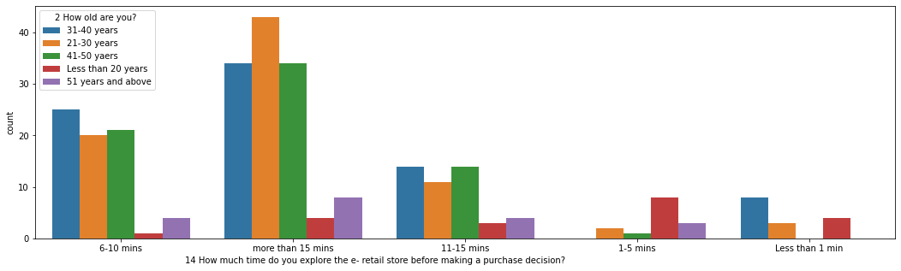
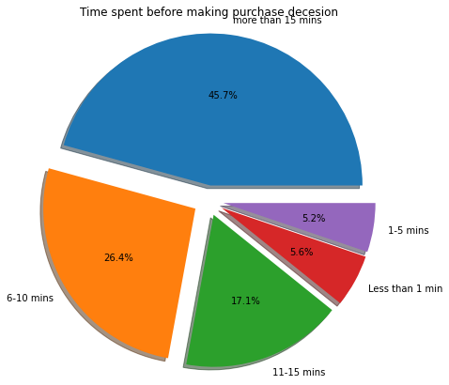
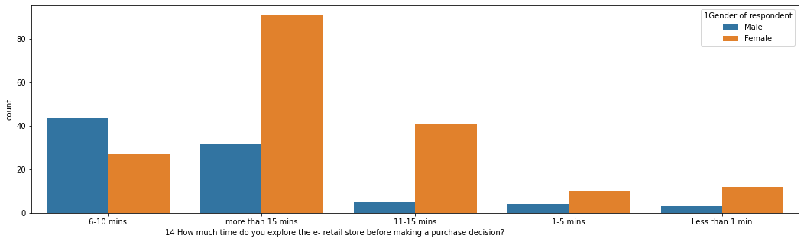
Visualization of data regarding the spent to make purchase decision
We can infer that
1) Majority of customers spend more than 15 minutes to make purchase decesion
2) Majority of customers who spend more than 15 minutes to make purchase decesion belongs to age group of 21-30 years
3) Majority of customers who spend more than 15 minutes to make purchase decesion are female

Slide 12
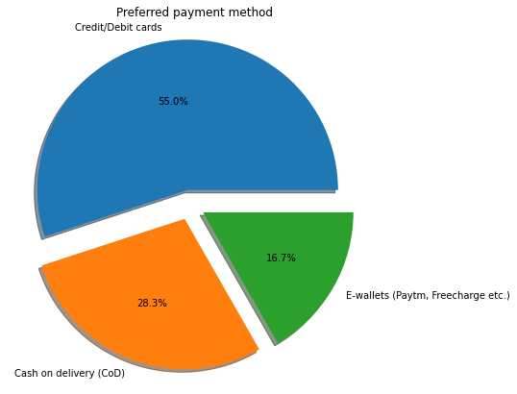
Visualization of data regarding preferred payment method
We can infer that most of the online shopping customers prefer payment through cards

Slide 13
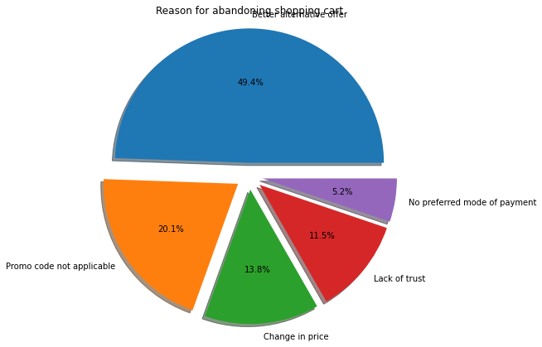
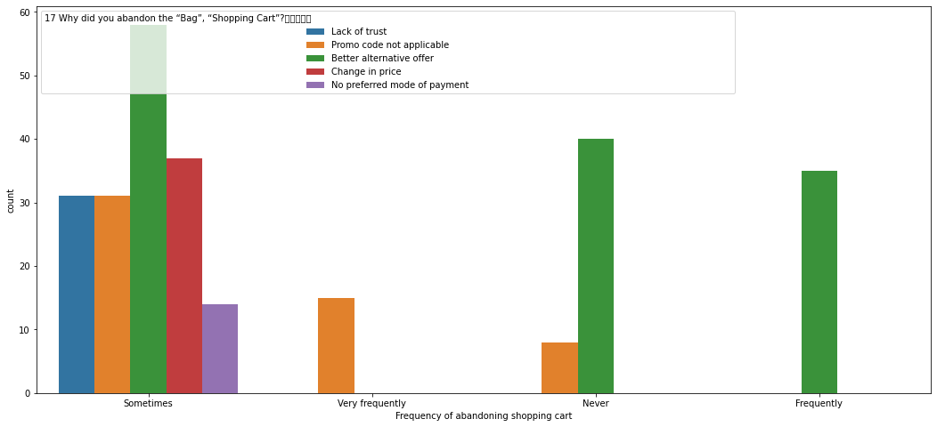
Visualization of data regarding frequency & reason of abandoning shopping cart
We can infer that sometimes online shopping customers abandon cart, due to better alternate offer available

Slide 14
Solution steps and methodologies used
Seperating factors affecting the customer retention or satisfaction as per feedback data
cr_coded = cr.iloc[:,17:47]
Finding coefficients of correlation of all against each other and plotting heatmap for vizualization
Since there are too many columns, lets prioritize and select factors based on highest value of coefficient of correlation with respect to target

Slide 15
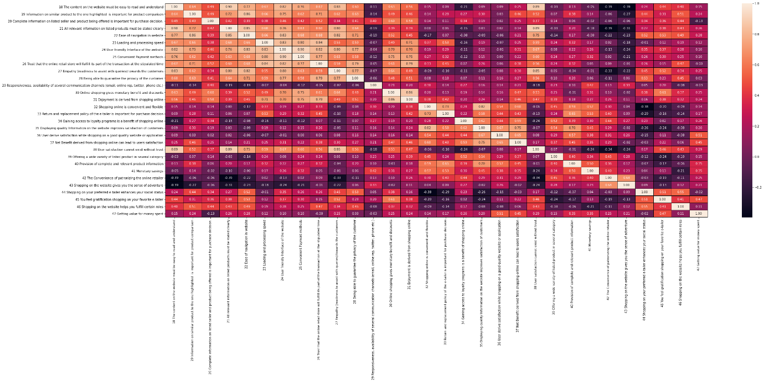
Finding coefficients of correlation of all against each other and plotting heatmap for vizualization

Slide 16
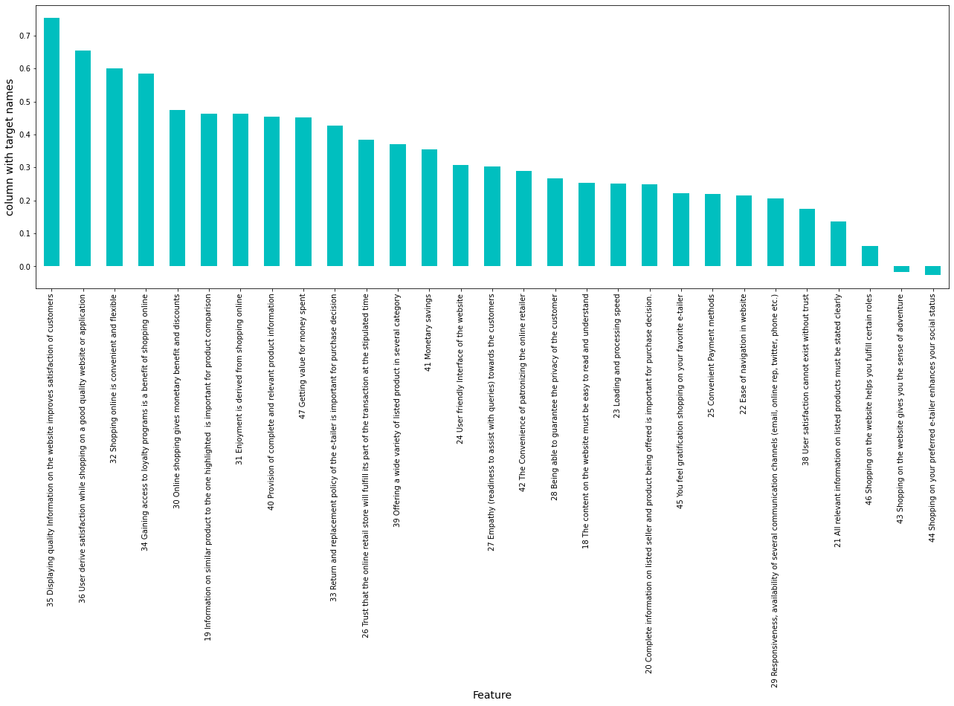
Considering 'Net Benefit derived from shopping online can lead to users satisfaction' as target feature
Factors affecting are displayed in descending order of coefficient of correlation
This means: 'Displaying quality Information on the website improves satisfaction of customers' influences the more to online shopping customers to buy products online

Slide 17
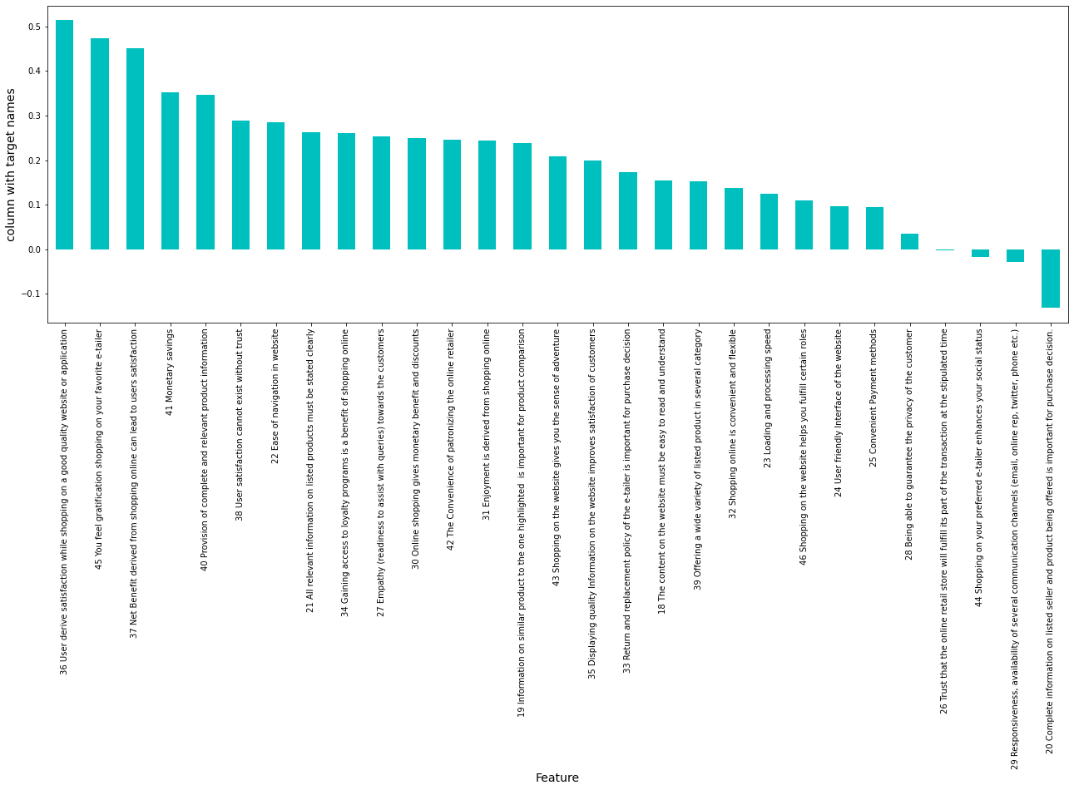
Considering 'Getting value for money spent' as target feature
Factors affecting are displayed in descending order of coefficient of correlation
This means: 'User derive satisfaction while shopping on a good quality website or application' influences online shopping customers to buy products online

Slide 18
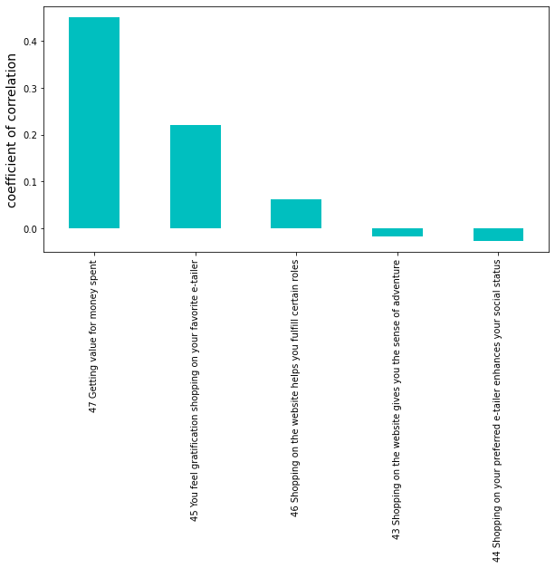
Lets check how various categorized factors correlated to the target
Let target be = '37 Net Benefit derived from shopping online can lead to users satisfaction'
Hedonic Value factors
1) Gratification:'45 You feel gratification shopping on your favorite e-tailer'
2) Role: '46 Shopping on the website helps you fulfill certain roles'
3) Best deal:'47 Getting value for money spent'
4) Social:'44 Shopping on your preferred e-tailer enhances your social status'
5) Adventure:'43 Shopping on the website gives you the sense of adventure‘
Factors affecting are displayed in descending order of coefficient of correlation
This means: 'Getting value for money spent' influences the more online shopping customers to buy products online

Slide 19
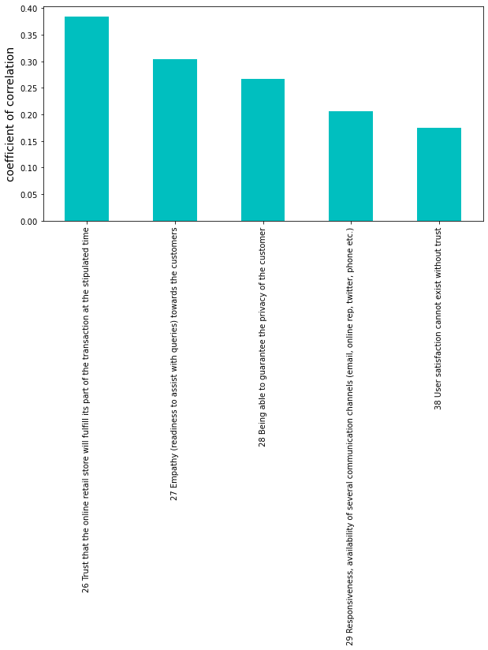
Lets check how various categorized factors correlated to the target
Risk presceived factors:
'26 Trust that the online retail store will fulfill its part of the transaction at the stipulated time'
'27 Empathy (readiness to assist with queries) towards the customers'
'28 Being able to guarantee the privacy of the customer'
'29 Responsiveness, availability of several communication channels (email, online rep, twitter, phone etc.)'
'38 User satisfaction cannot exist without trust‘
Factors affecting are displayed in descending order of coefficient of correlation
This means: 'Trust that the online retail store will fulfill its part of the transaction at the stipulated time' influences more online shopping customers to buy products online

Slide 20
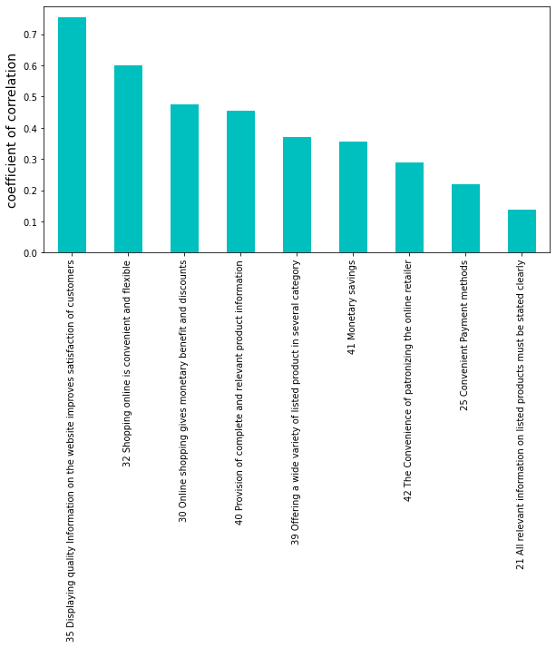
Lets check how various categorized factors correlated to the target
Utilitarian value factors:
1) Product offerings:
'39 Offering a wide variety of listed product in several category'
2) Convenience:
'25 Convenient Payment methods'
'32 Shopping online is convenient and flexible'
'42 The Convenience of patronizing the online retailer'
3) Product information:
'20 Complete information on listed seller and product being offered is important for purchase decision.'
'21 All relevant information on listed products must be stated clearly'
'35 Displaying quality Information on the website improves satisfaction of customers'
'40 Provision of complete and relevant product information'
4) Monitory saving:
'41 Monetary savings'
'30 Online shopping gives monetary benefit and discounts'
Factors affecting are displayed in descending order of coefficient of correlation
This means: 'Displaying quality Information on the website improves satisfaction of customers' influences more online shopping customers to buy products online

Slide 21
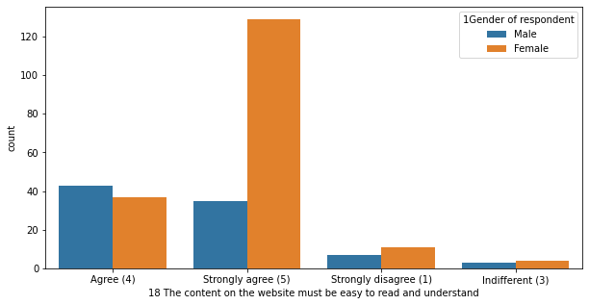
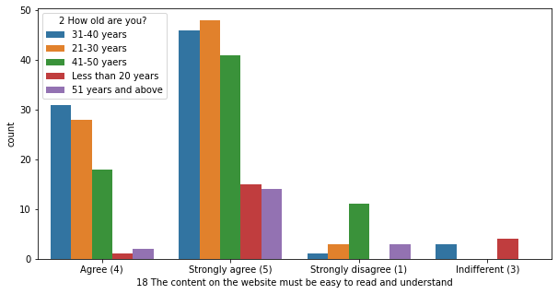
Infering from the above correlation analysis, lets consider following factors for further data analysis for customer satisfaction & retention
Inference:
1) Most of the online shopping customers who has opinion that 'The content on the website must be easy to read and understand' are female
2) Most of the online shopping customers who has opinion that 'The content on the website must be easy to read and understand' are of age group 21-30 years

Slide 22
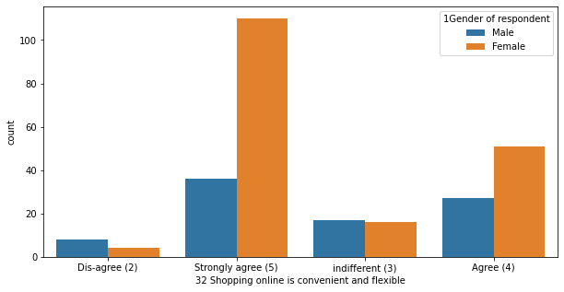
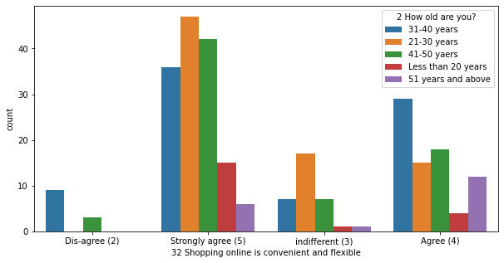
Infering from the above correlation analysis, lets consider following factors for further data analysis for customer satisfaction & retention
Inference:
1) Most of the online shopping customers who has opinion that 'Shopping online is convenient and flexible' are female
2) Most of the online shopping customers who has opinion that 'Shopping online is convenient and flexible' are of age group 21-30 years

Slide 23
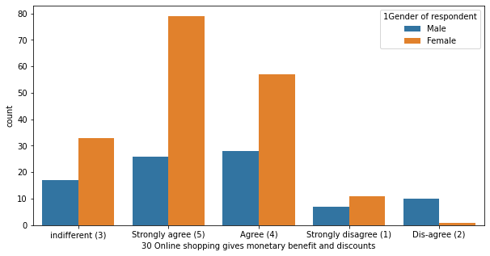
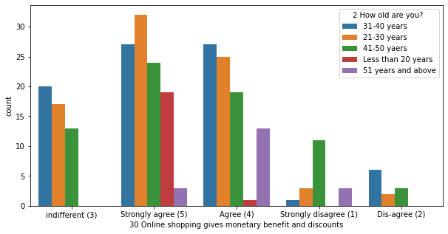
Infering from the above correlation analysis, lets consider following factors for further data analysis for customer satisfaction & retention
Inference:
1) Most of the online shopping customers who has opinion that 'Online shopping gives monetary benefit and discounts' are female
2) Most of the online shopping customers who has opinion that 'Online shopping gives monetary benefit and discounts' are of age group 21-30 years

Slide 24
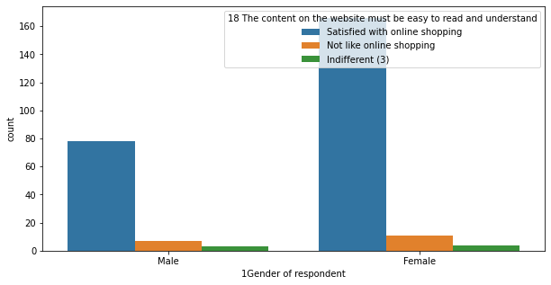
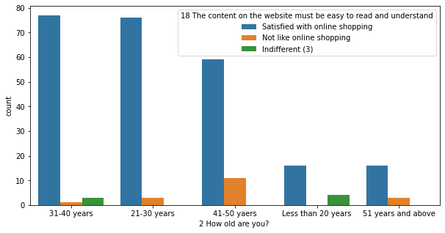
Merging Agree & Strongly agree and Disagree & Strongly disagree
Inference:
1) Most of the customers influenced strongly by 'The content on the website must be easy to read and understand' are female
2) Most of the customers influenced strongly by 'The content on the website must be easy to read and understand' are of age group 21-50 years

Slide 25
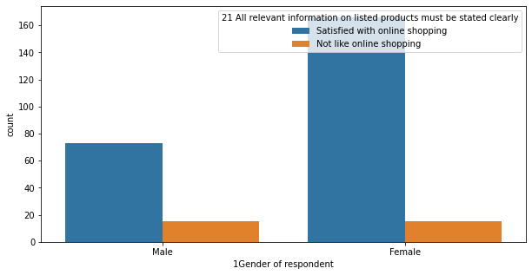
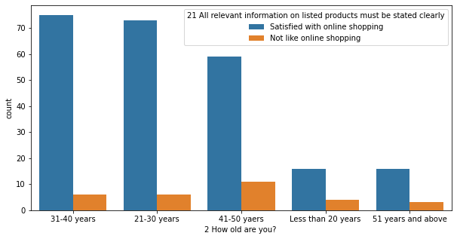
Merging Agree & Strongly agree and Disagree & Strongly disagree
Inference:
1) Most of the customers influenced strongly by 'All relevant information on listed products must be stated clearly' are female
2) Most of the customers influenced strongly by 'All relevant information on listed products must be stated clearly' are of age group 21-50 years

Slide 26
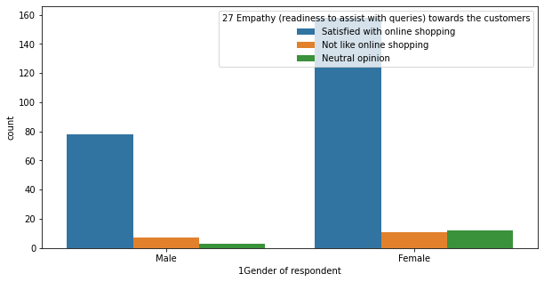
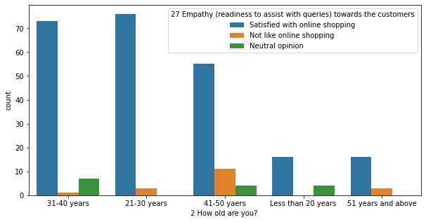
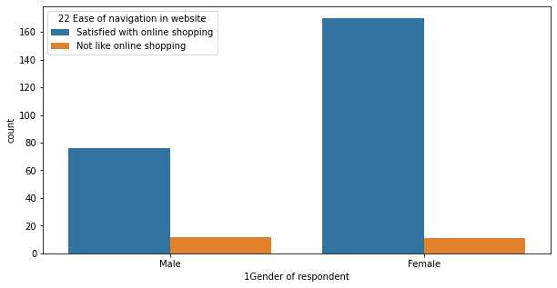
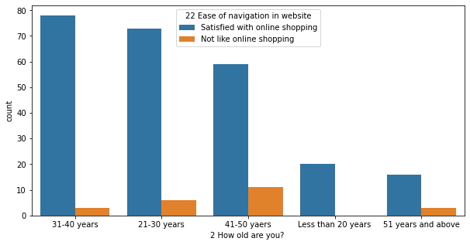
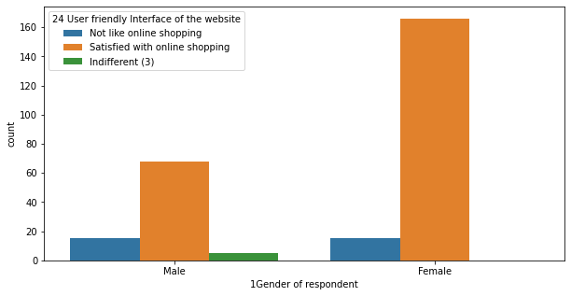
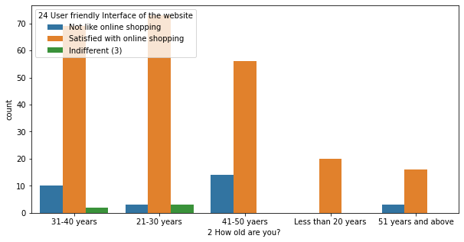
Merging Agree & Strongly agree and Disagree & Strongly disagree

Slide 27
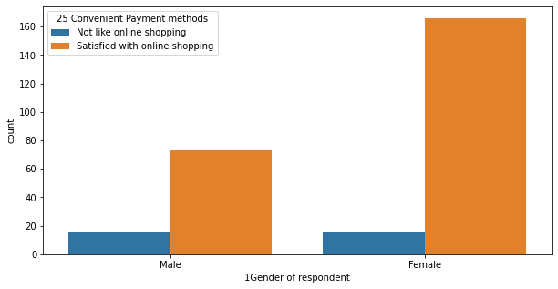
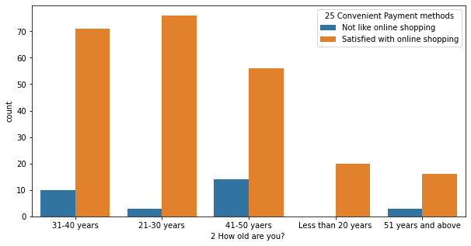
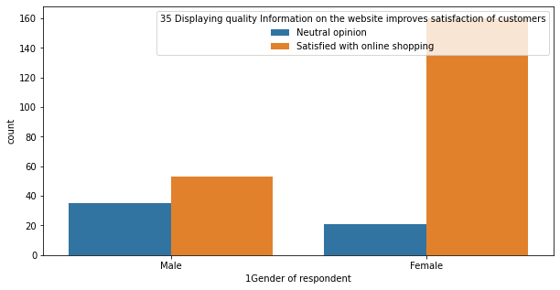
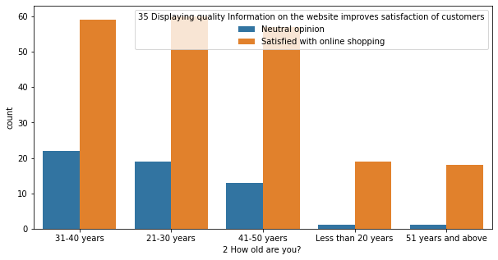
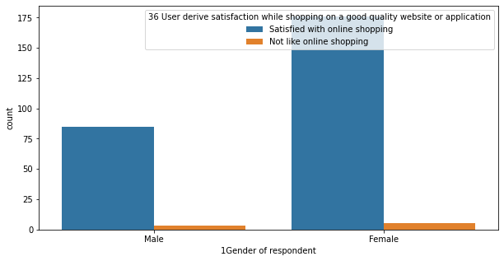
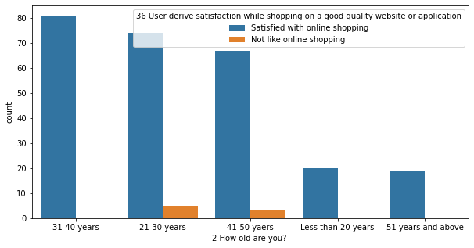
Merging Agree & Strongly agree and Disagree & Strongly disagree

Slide 28
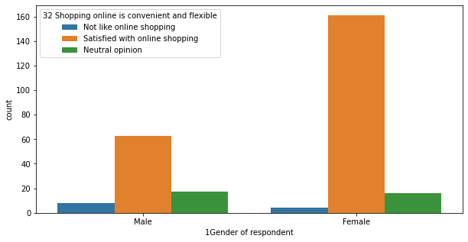
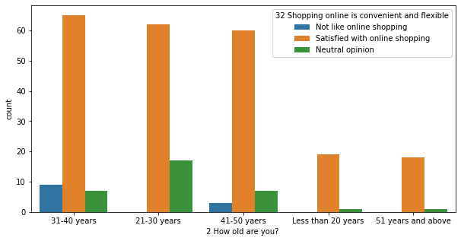
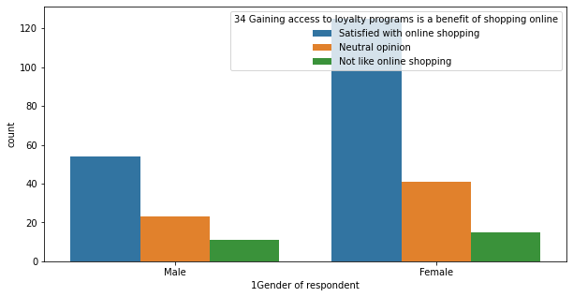



Merging Agree & Strongly agree and Disagree & Strongly disagree
Conclusion:
We can infer that female under the age group of 21-50 years are agreeing/strongly agreeing for the considered factors influening the decesion for online shopping, hence it can be considered that they are satisfied for online shopping based on that particular factor is satisfying

Slide 29

Solution steps and methodologies used
For remaining data from column no.48 onwards, regarding website or multiple website option chosen
First we will unwrap the multidimensional list and form list containing single elements of chosen website as feedback data
Since entries have multiple values or options selected, unwrapping and finding feedback chosen as whole will give fruitful results
Then doing correlation analysis and plotting heat-map

Slide 30

Finding coefficients of correlation of all against each other and plotting heatmap for vizualization

Slide 31

Visualization of descending order of coefficient of correlation
Since there are too many columns, lets prioritize and select factors based on highest value of coefficient of correlation with respect to target "Which of the Indian online retailer would you recommend to a friend?"
Inference:
1) High +ve correlation with target: 'Privacy of customers’ information'
2) High -ve correlation with target: 'Longer delivery period'

Slide 32


Visualization of voting of customers for different online retailers
Inference:
1) Based on 'Privacy of customers’ information' Amazon.in is preferred most for online shopping
2) Based on 'Presence of online assistance through multi-channel' Amazon.in is preferred most for online shopping

Slide 33



Visualization of voting of customers for different online retailers
Inference:
1) Based on 'Visual appealing web-page layout' Amazon.in is preferred most for online shopping
2) Based on 'Reliability of the website or application' Amazon.in is preferred most for online shopping
3) Based on 'Wild variety of product on offer' Amazon.in is preferred most for online shopping

Slide 34



Visualization of voting of customers for different online retailers
Inference:
1) Based on 'Availability of several payment options' Amazon.in is preferred most for online shopping
2) Based on 'Longer page loading time (promotion, sales period)' Paytm.com is not preferred most for online shopping
3) Based on 'Longer delivery period' Paytm.com and Snapdeal.com are not preferred most for online shopping

Slide 35

Visualization of voting of customers for different online retailers:
Based on Company/online retailer recommendable to a friend

Slide 36
Conclusion:
Majority of customers have voted for Amazon.in followed by Flipkart.com and Myntra.com as the retailer recommendable to a friend
This means they are also satisfied with their online shopping experience with that online retailer and have been retained as customers for future also

Slide 37
Thank you

